Slide 1




NEXT GEN EMPLOYABILITY PROGRAM
Creating a future-ready workforce
Team Members:1
College Name
Student Name : Yogeshwaran
Student ID : 412321104318
SRI RAMANUJAR ENGINEERING COLLEGE

Slide 2

CAPSTONE PROJECT SHOWCASE
Project Title
MUSIC WEB APPLICATION USING DJANGO FRAMEWORK
Abstract | Problem Statement | Project Overview | Proposed Solution | Technology Used | Modelling & Results | Conclusion

Slide 3
Abstract
The Django project discussed here presents a dynamic music web application, emphasizing user authentication and database management. With seamless signup and login functionalities, users access a curated index of songs, enabling exploration of diverse musical content. Leveraging Django's robust framework, the application delivers a fluid and responsive user experience, blending aesthetic appeal with functional efficiency. Through intuitive search features and responsive design elements, users navigate the music library effortlessly. The project demonstrates the fusion of frontend and backend components, achieving a harmonious balance between visual appeal and robust functionality. Employing CSS for styling and JavaScript for interactivity, the application prioritizes user engagement and accessibility across devices. In essence, this Django project showcases innovation in web development, underscoring Django's versatility in creating immersive and user-centric applications for music enthusiasts.
Source :

Slide 4
Problem Statement
In the digital age, there is a burgeoning demand for immersive and user-centric music web applications that seamlessly integrate authentication systems and database management functionalities. Existing platforms often lack the robustness and fluidity required to deliver a cohesive user experience, leading to user dissatisfaction and reduced engagement.
The absence of intuitive search features and responsive design elements further exacerbates usability issues, hindering users' ability to explore and enjoy diverse musical content effectively. There is a pressing need for a solution that addresses these shortcomings by leveraging advanced web development frameworks and technologies to create a dynamic music platform that prioritizes user authentication, database management, intuitive navigation, and responsive design.
This solution aims to set a new standard for excellence in music web applications, catering to the evolving needs and expectations of modern music enthusiasts.
Source :

Slide 5
Project Overview
My Django project presents a music-related web application with a visually appealing interface crafted using HTML, database, python, CSS, and Bootstrap. Navigation links facilitate easy access to different sections like Home, Playlist, Artists, and Favourites. Bootstrap's responsive grid system and components ensure seamless viewing across various devices. Cards elegantly display music content such as songs and artists, each accompanied by a play button for instant playback. The navbar incorporates a search form for user convenience. Despite embedding CSS styles within the HTML, the project demonstrates potential for expansion and refinement, including the incorporation of Django's ORM for database interactions, authentication mechanisms for user management, and further enhancements to functionality and design. With continued development, the project promises to offer an immersive and enjoyable music exploration experience for users.
Source :

Slide 6
Proposed Solution
I’ve stored the user credentials which got from signup in Django sqlite3 database.
The authentication process were done with the use of predefined Django-functions from django.contrib.auth.forms import AuthenticationForm
And linked the websites using python(Django) .
Some of the normal pages were redirected by using anchor tags(<a></a>)
Images, audio And css were included externally in django by using inbuilt code STATIC_URL = "static/"
I’m improved my code by using youtube videos and some ai tools.
Source :

Slide 7


Technology Used
Front-end
Back-end
Source :

Slide 8
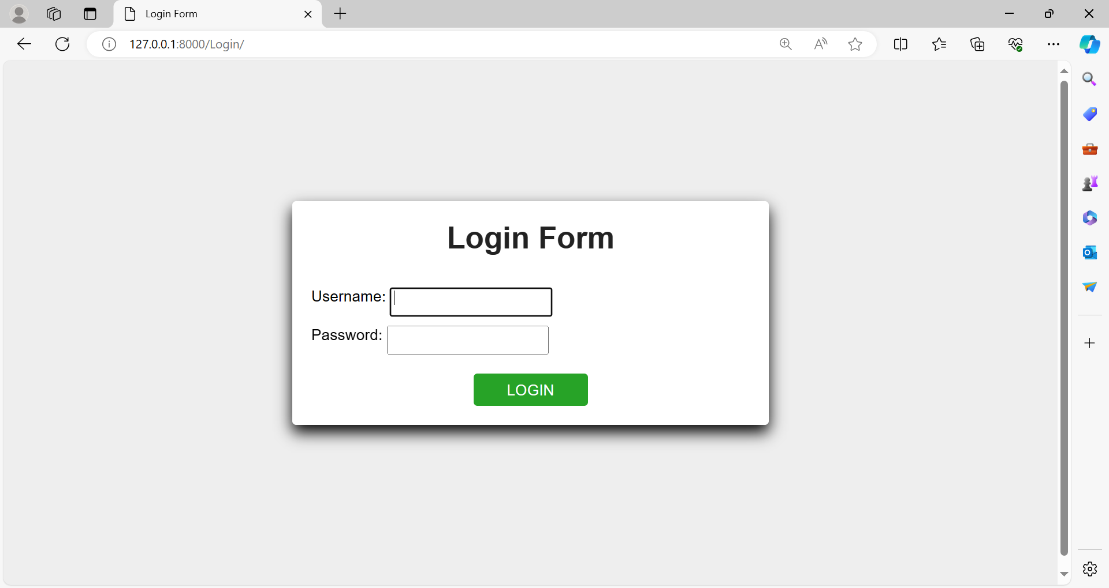
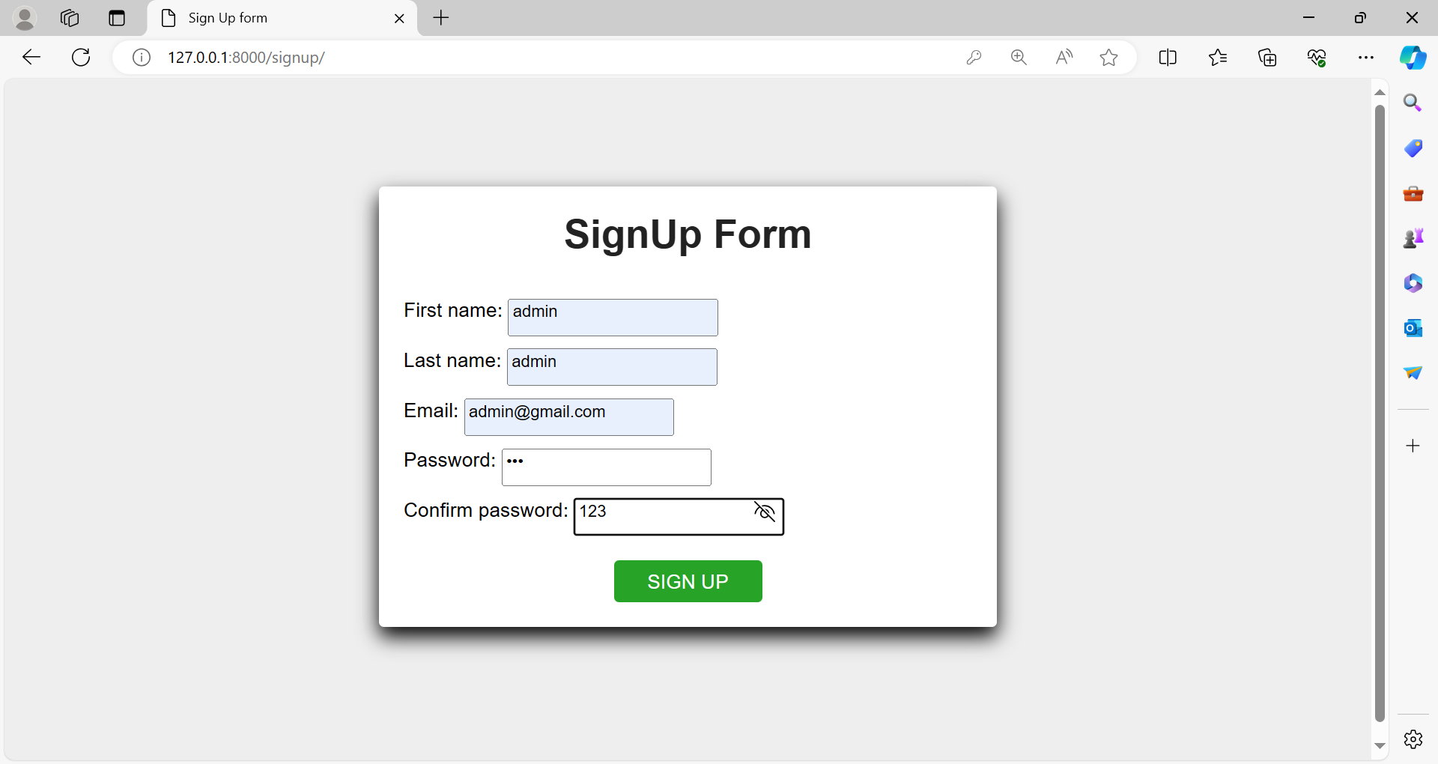
Modelling & Results
Login page of my website
SignUp page of my website
Source :

Slide 9
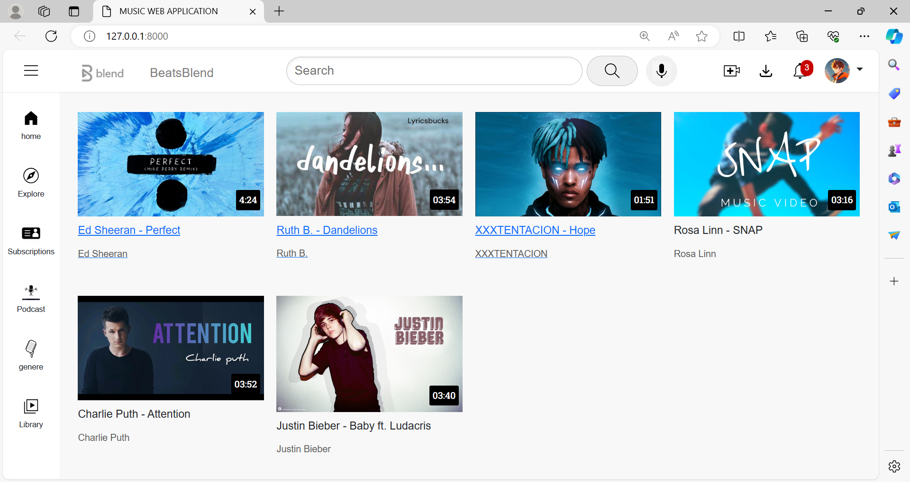
Homepage
Reference: youtube.html

Slide 10
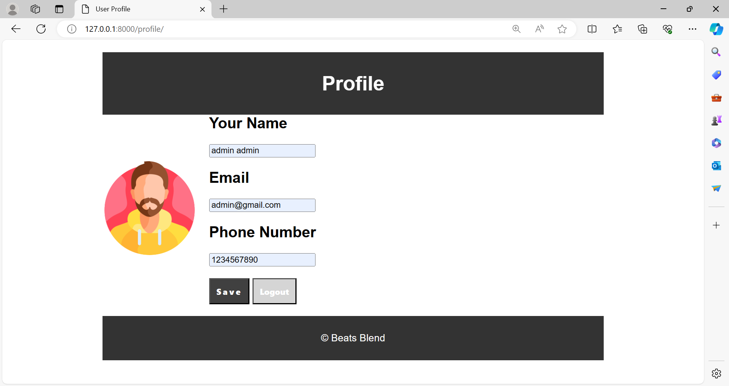
Profile-Page

Slide 11
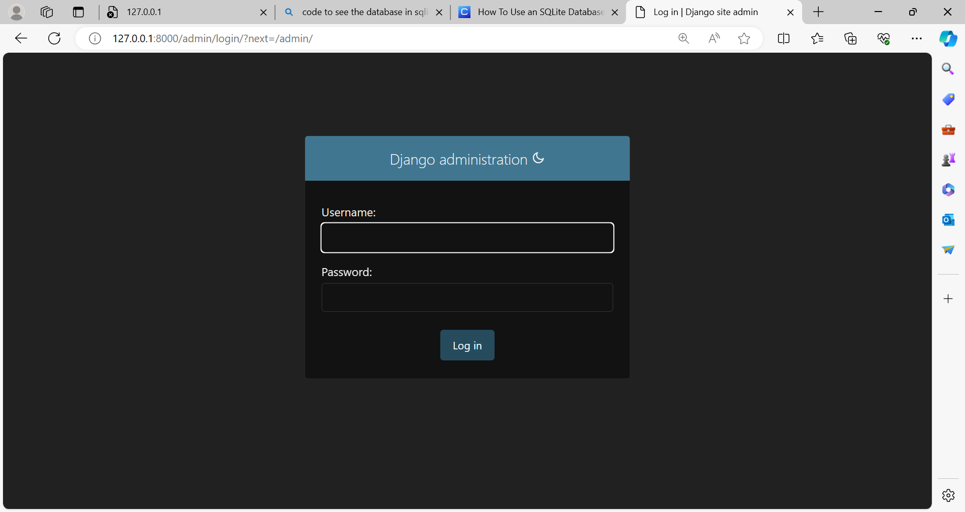
Login-Admin-Page

Slide 12
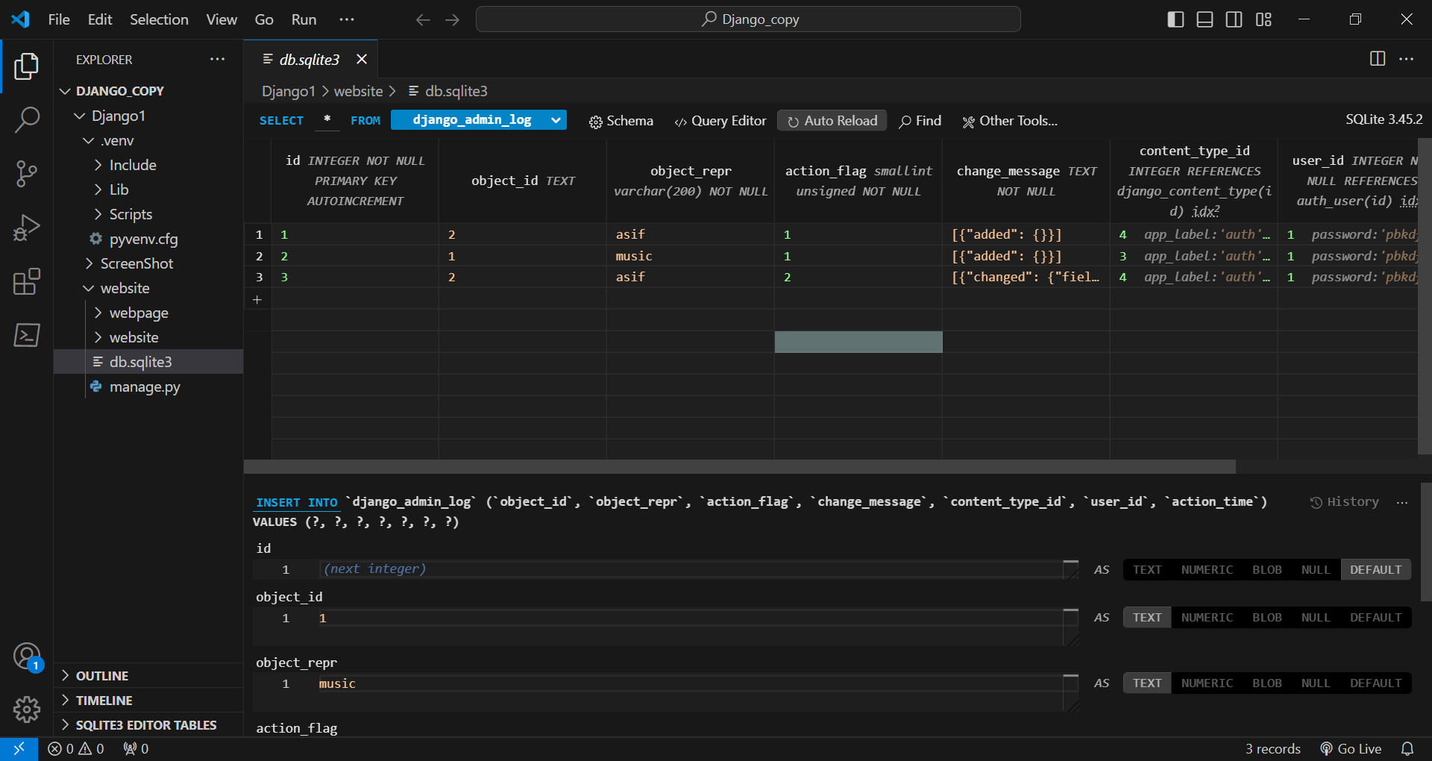
Database

Slide 13
Future Enhancements: 1. Enhanced Recommendation Engine: Implement machine learning algorithms to improve the accuracy and relevance of music recommendations. Incorporate collaborative filtering, content-based filtering, and hybrid recommendation approaches.Allow users to provide feedback on recommended songs to further refine the recommendation algorithm. 2. Social Collaboration Features: Expand social features to enable collaborative playlist creation among multiple users.Introduce group listening sessions where users can listen to the same playlist simultaneously and chat in real-time. 3. Integration with Emerging Technologies: Explore integration with voice assistants (e.g., Amazon Alexa, Google Assistant) to enable voice-controlled music playback and interaction.Implement support for virtual reality (VR) and augmented reality (AR) technologies to create immersive musicexperiences and virtual concert venues. 4. Live Streaming and Concert Integration: Partner with artists and event organizers to provide live streaming of concerts, music festivals, and exclusive performances within the app.Offer virtual tickets to live events and virtual meet-and-greets with artists for premium subscribers.

Slide 14
Conclusion
The music web application developed using Django showcases a promising foundation for a dynamic and engaging platform. By leveraging HTML, CSS, and Bootstrap, the project delivers a visually appealing interface with intuitive navigation and responsive design. The integration of Django's backend functionalities offers opportunities for robust database management and user authentication. Moving forward, the project has ample potential for expansion, including the implementation of additional features such as personalized playlists, user interaction mechanisms, and enhanced content discovery algorithms. With continued refinement and innovation, the project aims to provide music enthusiasts with a compelling and immersive experience tailored to their preferences and interests.
Source :

Slide 15
Thank You!
Notes:
Thank You !!

